Slide 1
Array Vocabulary
Unit 4

Slide 2
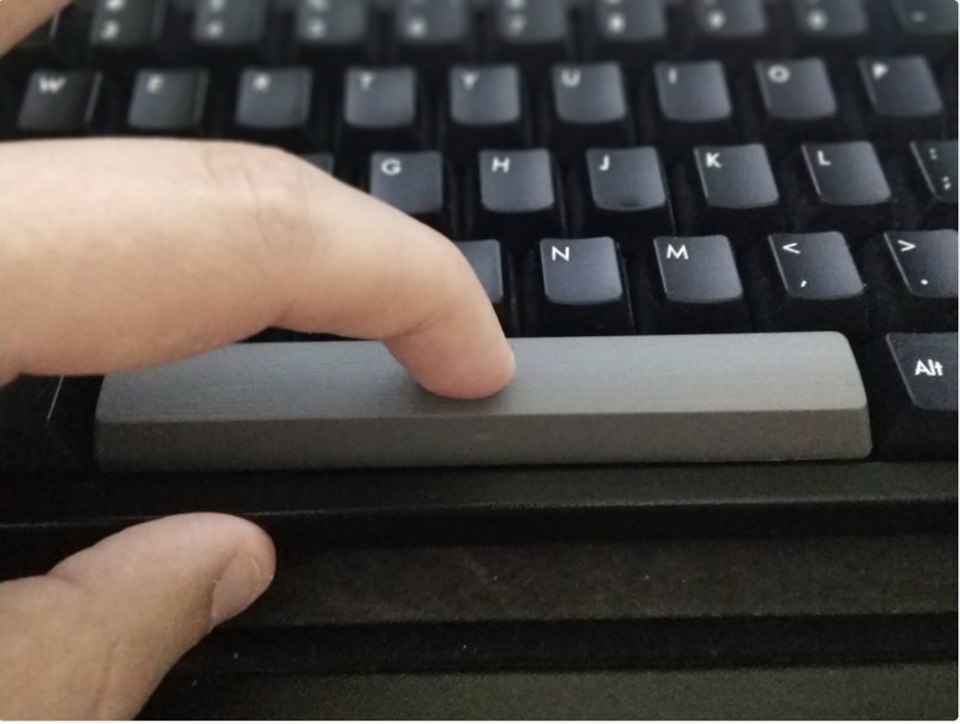
Welcome
Please click the spacebar to continue your vocabulary review in the next slides.

Slide 3
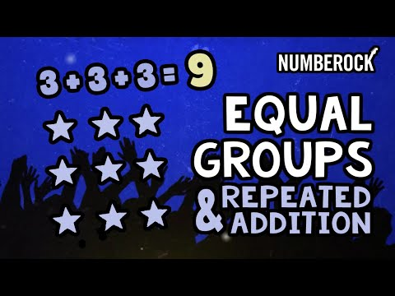
Let’s review!!!!
Let’s begin by dancing our way into an Array review! Watch the following 3 minute video:

Slide 4
Vocabulary word: Array
An Array is an equal group of rows and columns.
Examples:

Slide 5
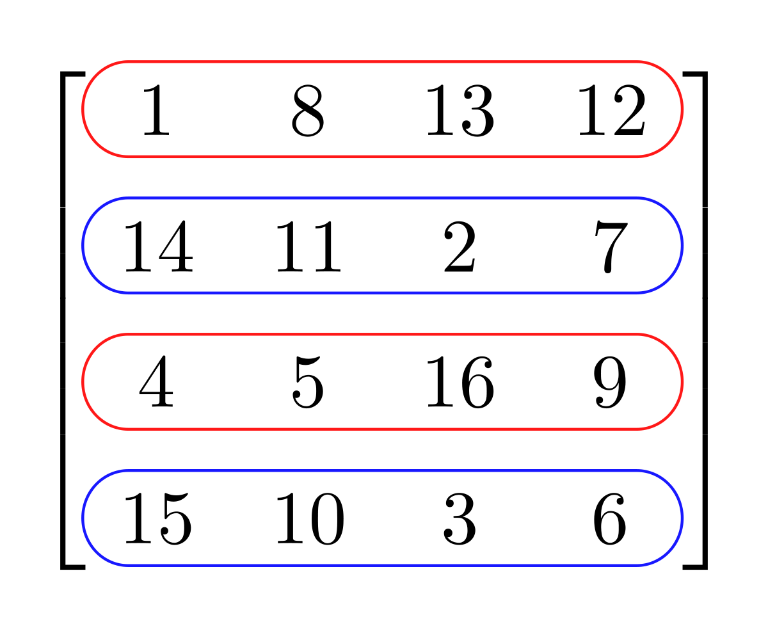
Vocabulary word: Row
A Row is a horizontal line that goes side to side. Always remember the directions your arms move when you row a boat!
Examples:

Slide 6
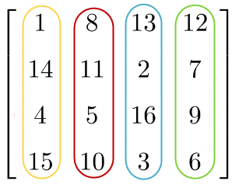
Vocabulary word: Column
A Column is a vertical line that travels up and down.
Examples:

Slide 7
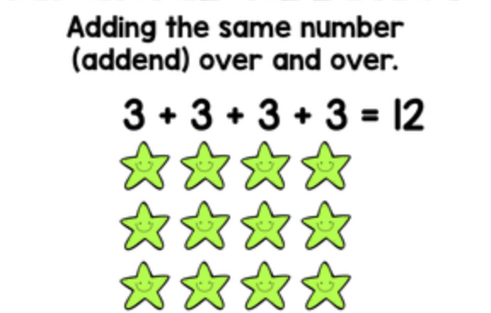
Vocabulary word: Repeated Addition Equation
A Repeated Addition Equation is made out of either the number of rows or columns and adding up how much is inside each row or column.
Examples:

Slide 8
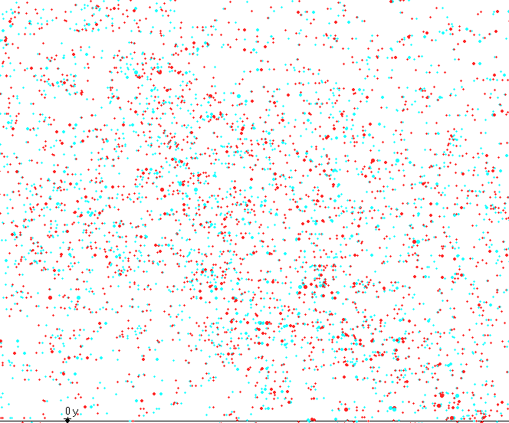
Final Step!!!!!
Great work! Now you must complete your Eureka math homework by clicking the button bellow! You can use your ipad to utilize the pen tool OR you can take pictures of your work and save them to your ipad.

